Slide 1



Sequential Sampling in Value-Based Decisions: Attention in Losses and Dynamic Evidence Weights
Brenden Eum

Slide 2
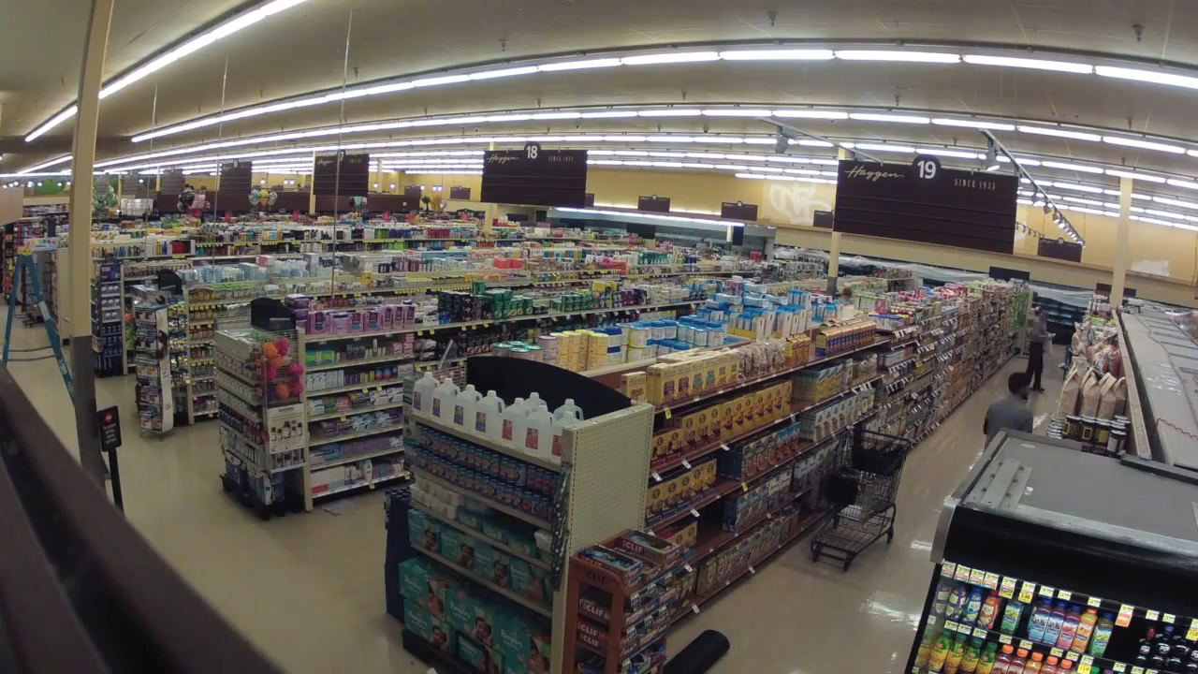

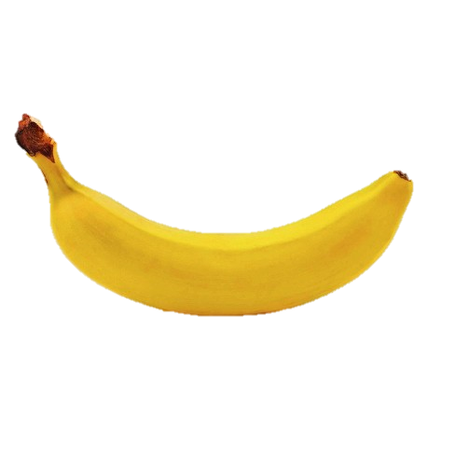
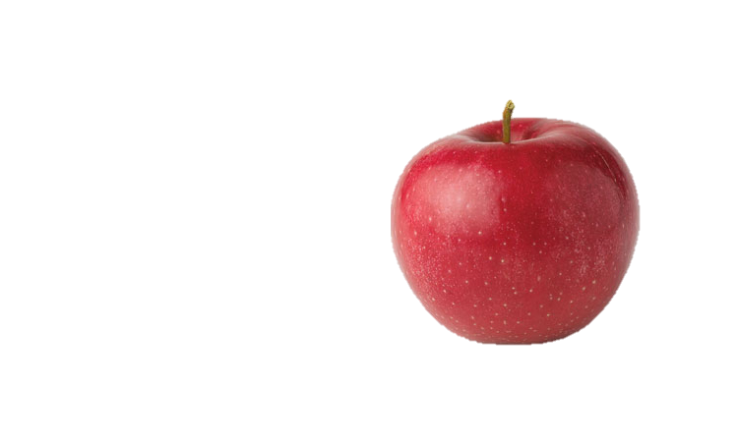
Brenden Eum

Slide 3
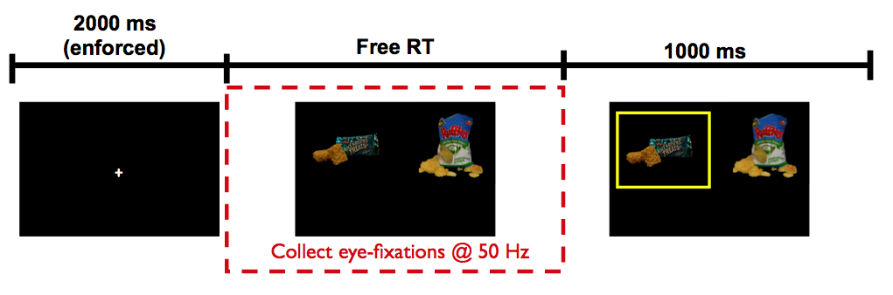
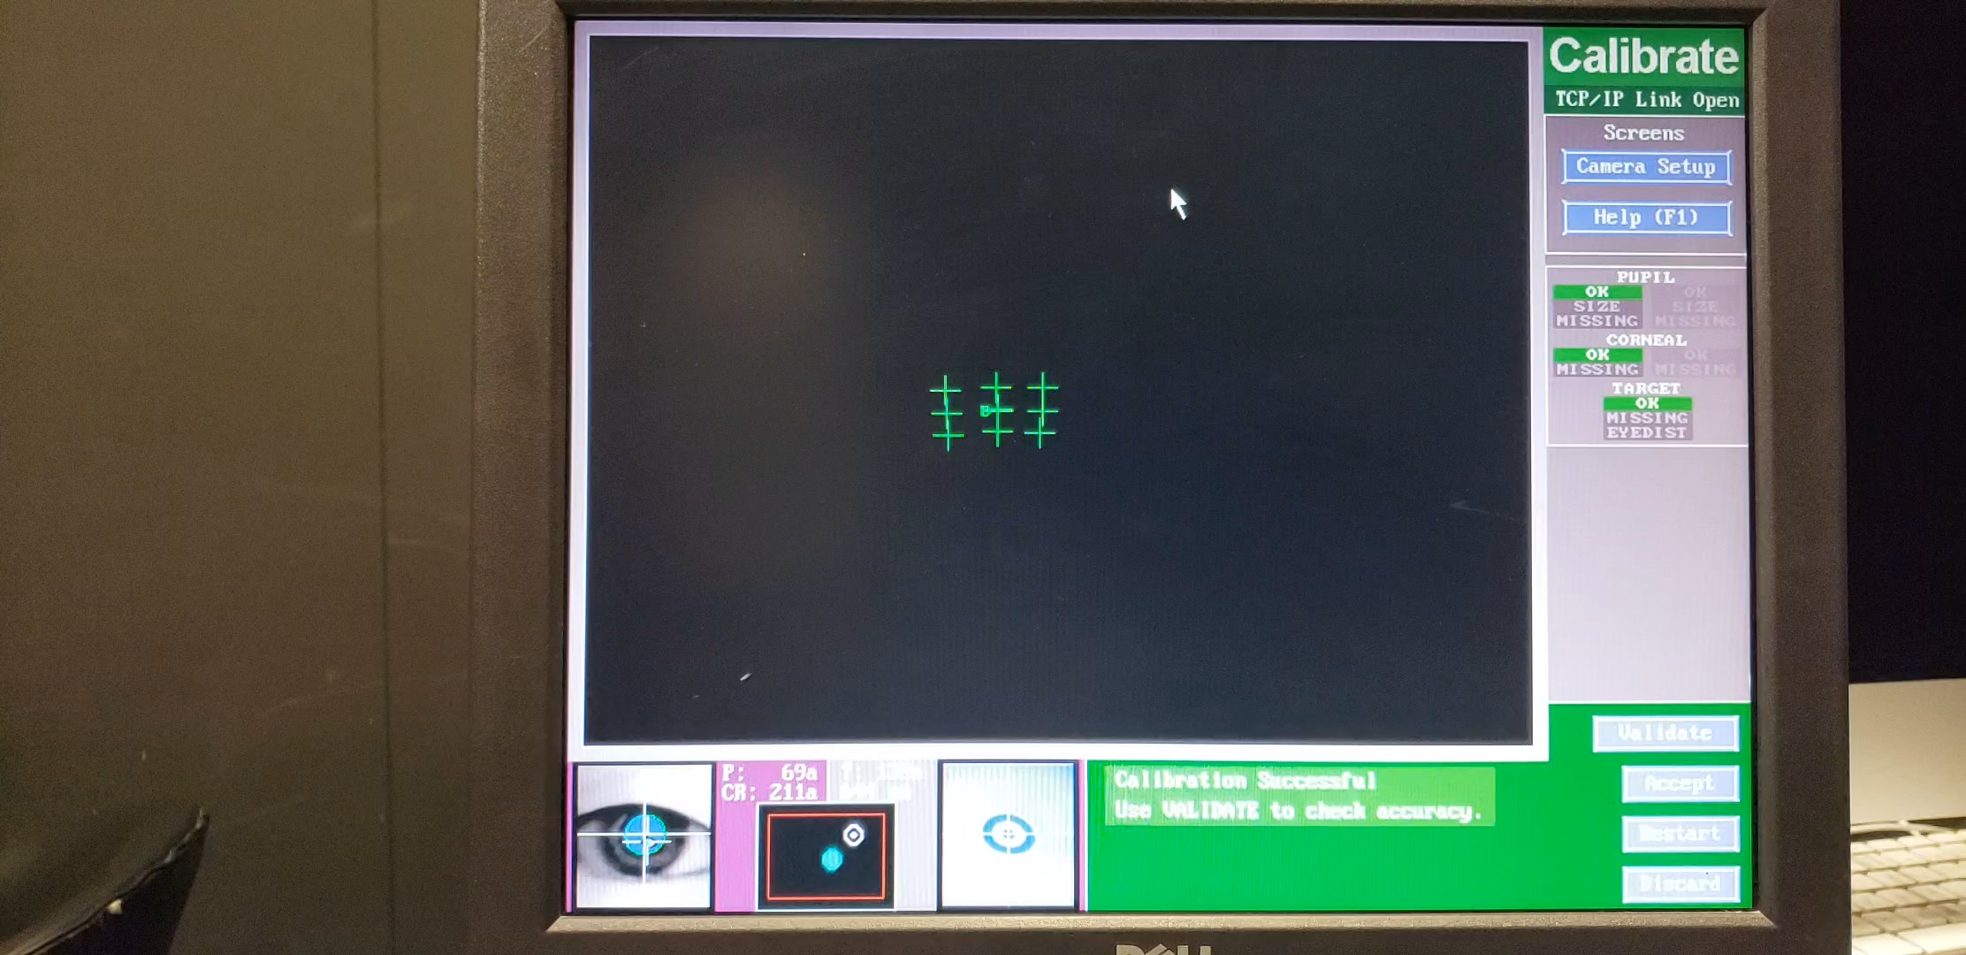
BE: replace this with video of task + ET marker
Krajbich, Armel, Rangel (2010, Nat Neuro)
Brenden Eum
Attention in Losses | Dynamic Evidence Weights

Slide 4
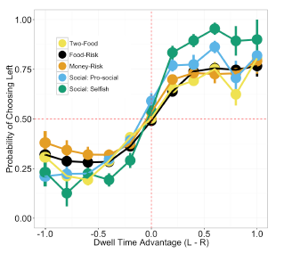
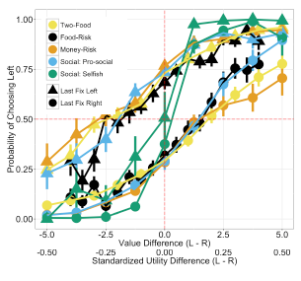
Net Fixation Bias
Last Fixation Bias
Smith, Krajbich (2018, J Exp Psychol Gen)
Brenden Eum
Notes:
multiple domains

Slide 5
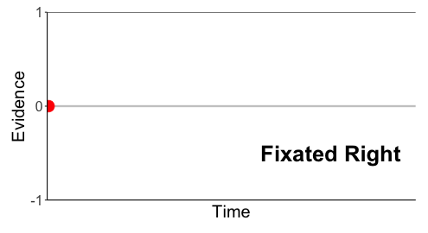
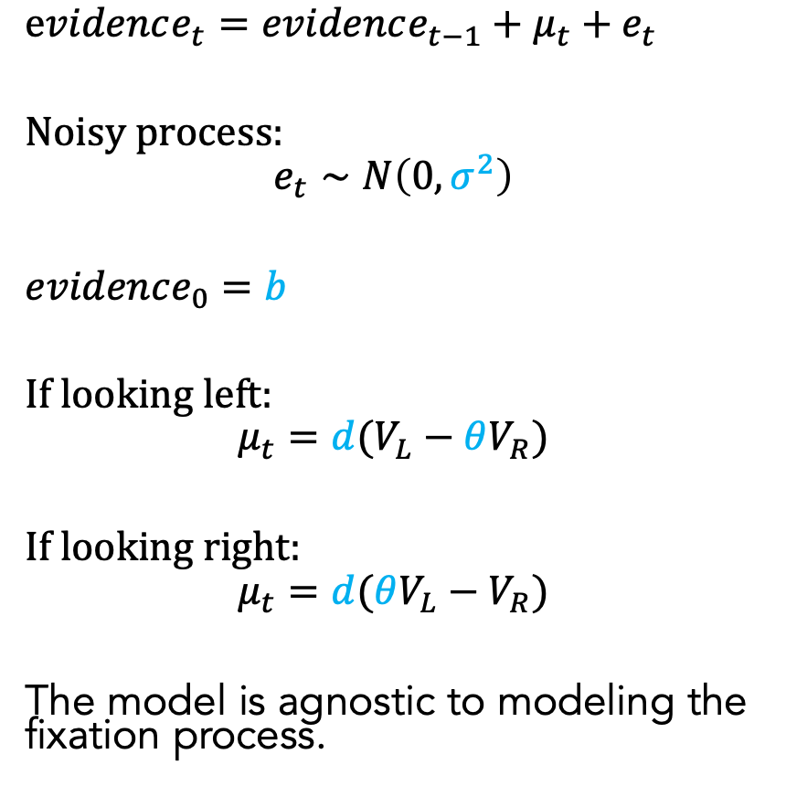
Attentional Drift-Diffusion-Model (aDDM)
$evidence_{t}=evidence_{t−1}+μ_{t}+e_{t}$
Noisy process:
$$e_{t}∼N\left(0, σ^{2}\right)$$
$evidence_{0}=b$
If looking left:
$$μ_{t}=d(V_{L}−θV_{R})$$
If looking right:
$$μ_{t}=d(θV_{L}−V_{R})$$
The model is agnostic to modeling the fixation process.
Pick Left
Pick Right
Brenden Eum
Attention in Losses | Dynamic Evidence Weights
Notes:
noisy
bias
drift: ddm in value based decisions: evidence accumulated is value comparison
drift
sim
explain fixation sampling process

Slide 6
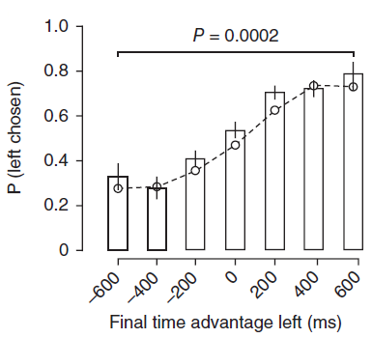
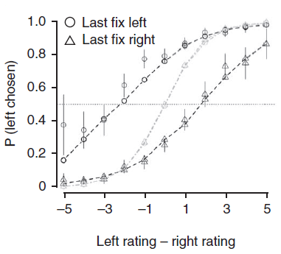
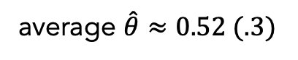
aDDM Predictions
average $\hat{θ}≈0.52 (.3)$
1. Attentional Discounting
2. Net Fixation Bias
3. Last Fixation Bias
Krajbich, Armel, Rangel (2010, Nat Neuro)
Krajbich, Armel, Rangel (2010, Nat Neuro)
Brenden Eum

Slide 7
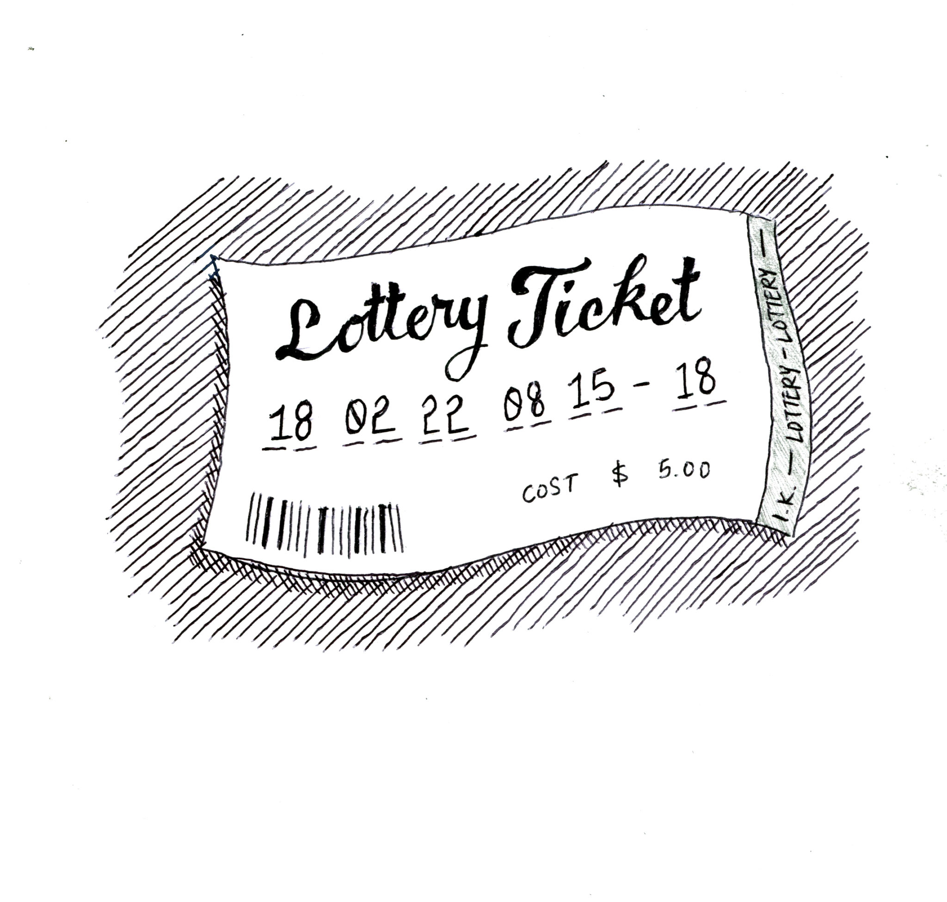
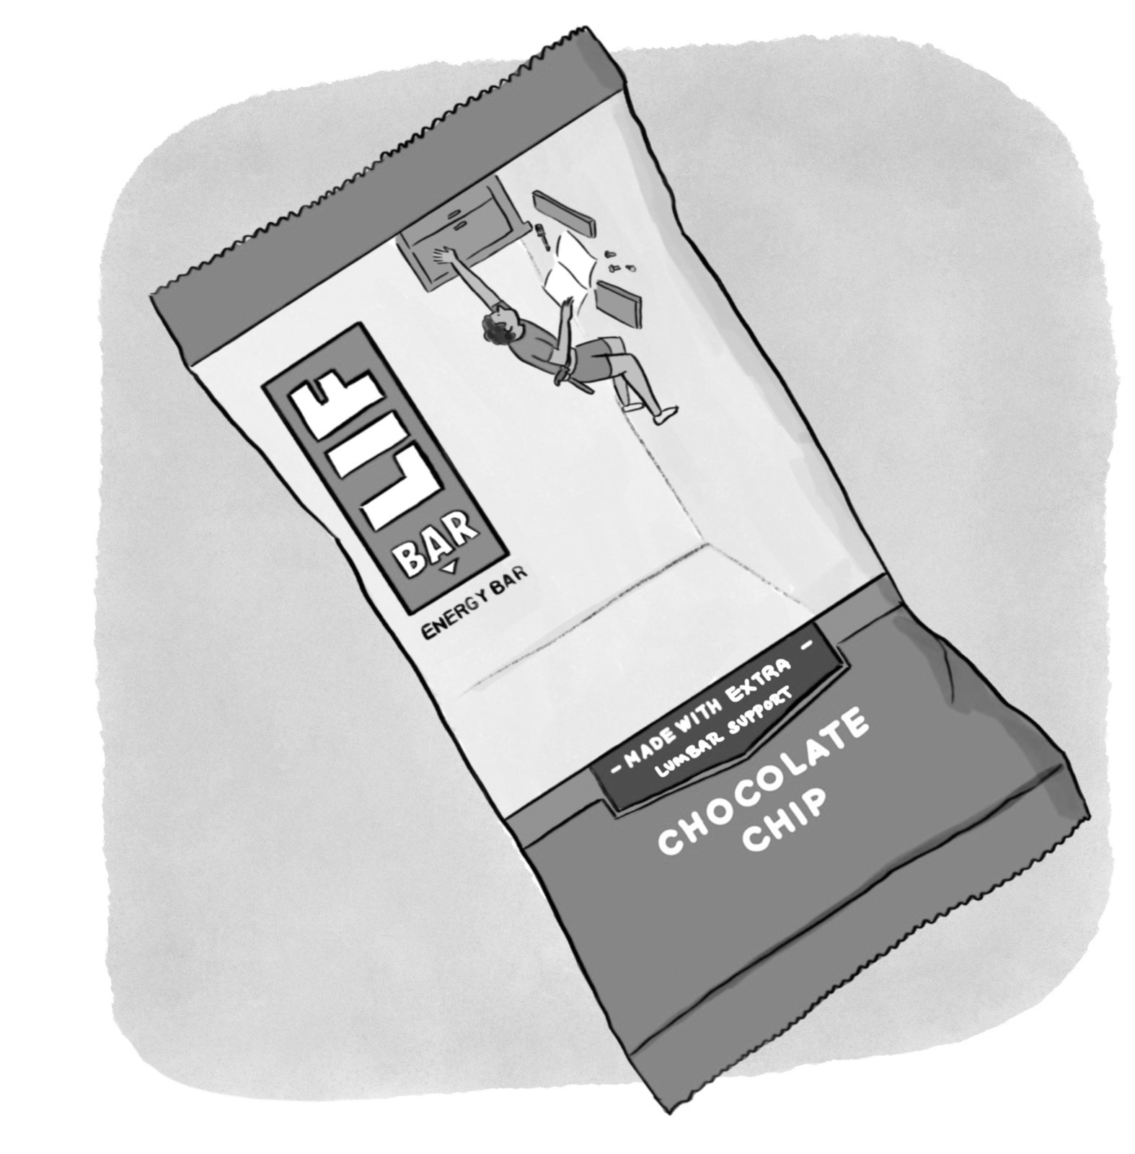
0
See Smith, Krajbich (2018, J Exp Psychol Gen); Bhatnagar, Orquin (2022, J Exp Psychol Gen); Fiedler, Glöckner (2012, Front Psychol)
Brenden Eum

Slide 8
?
0
See Smith, Krajbich (2018, J Exp Psychol Gen); Bhatnagar, Orquin (2022, J Exp Psychol Gen); Fiedler, Glöckner (2012, Front Psychol)
Brenden Eum

Slide 9

How does attention affect our choice process in aversive choices?
?
0
See Smith, Krajbich (2018, J Exp Psychol Gen); Bhatnagar, Orquin (2022, J Exp Psychol Gen); Fiedler, Glöckner (2012, Front Psychol)
Brenden Eum

Slide 10
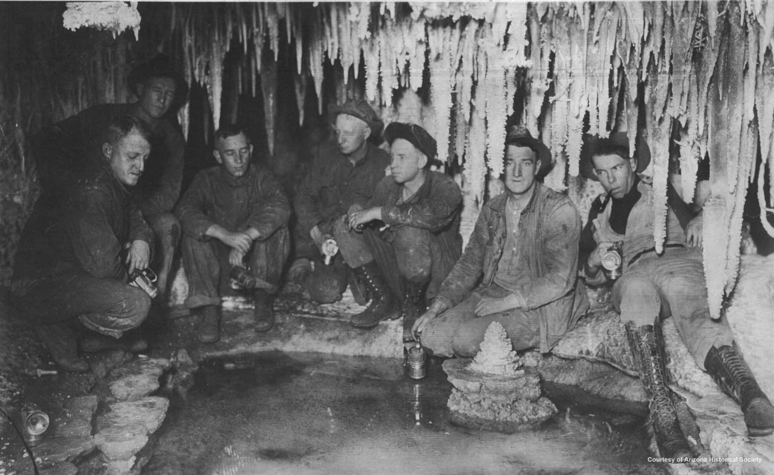
0
Copper Miners in Bisbee, Arizona
Brenden Eum

Slide 11
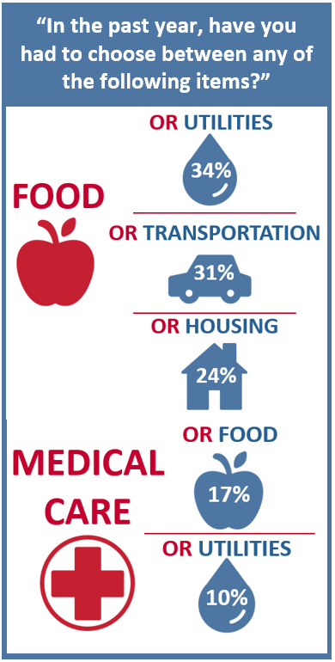
The Center for Community Solutions, Cleveland, Ohio

Slide 12
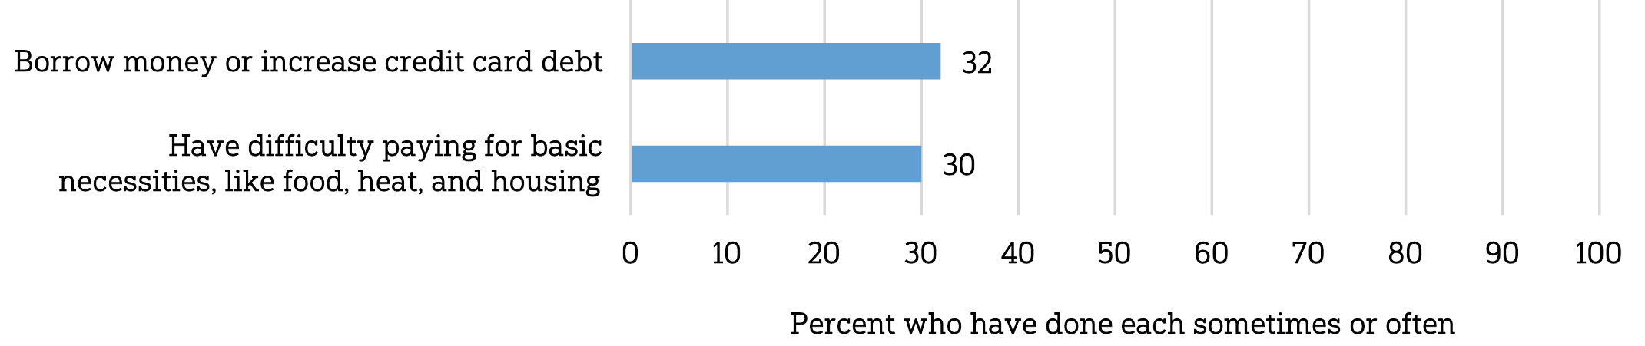
Does paying for healthcare costs cause you to…
The Center for Community Solutions, Cleveland, Ohio
NORC @ U Chicago / West Health Institute (2018)
Notes:
Aversive choices can have extremely large consequences. Is attention causing people to make mistakes?

Slide 13
Does paying for healthcare costs cause you to…
How does attention affect our choice process in aversive choices?
The Center for Community Solutions, Cleveland, Ohio
NORC @ U Chicago / West Health Institute (2018)
Notes:
Aversive choices can have extremely large consequences. Is attention causing people to make mistakes?

Slide 14
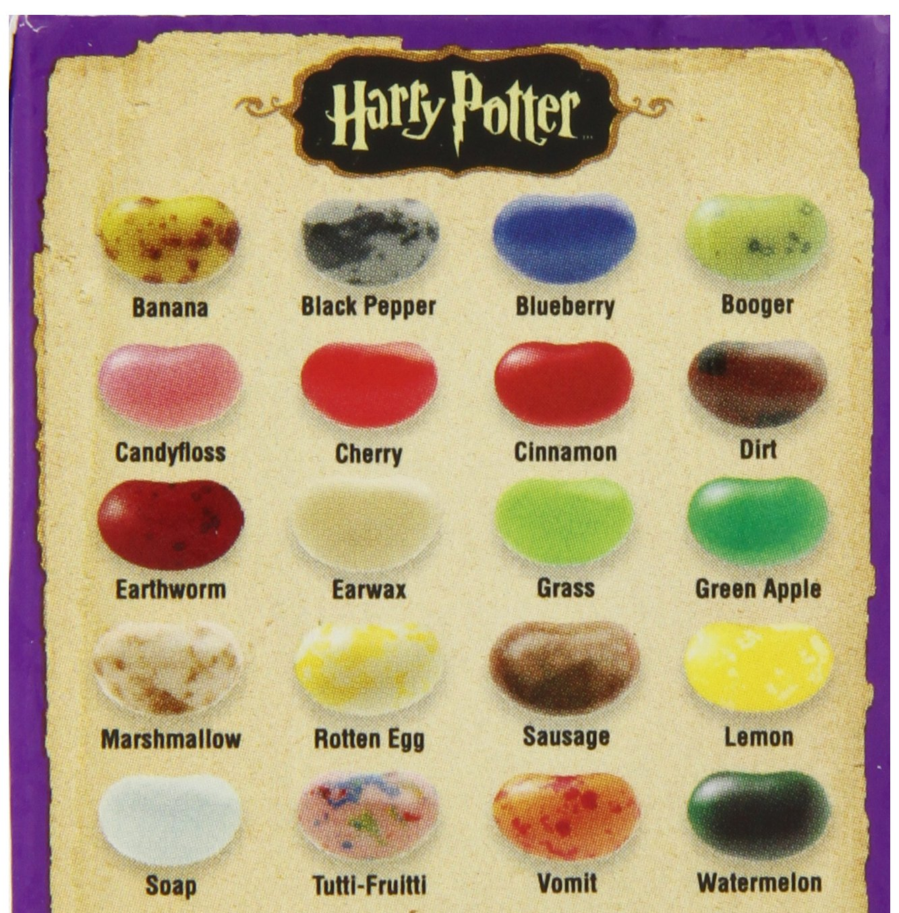
aDDM Prediction

Slide 15
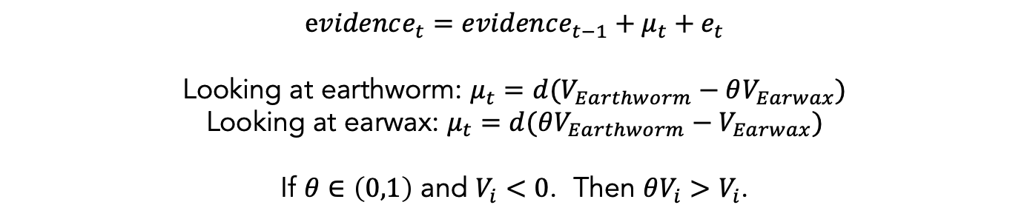
$evidence_{t}=evidence_{t−1}+μ_{t}+e_{t}$
Looking at earthworm: $μ_{t}=d(V_{Earthworm}−θV_{Earwax})$
Looking at earwax: $μ_{t}=d(θV_{Earthworm}−V_{Earwax})$
If $θ∈\left(0,1\right)$ and $V_{i}<0$. Then $θV_{i}>V_{i}$.

Slide 16
$evidence_{t}=evidence_{t−1}+μ_{t}+e_{t}$
Looking at earthworm: $μ_{t}=d(V_{Earthworm}−θV_{Earwax})$
Looking at earwax: $μ_{t}=d(θV_{Earthworm}−V_{Earwax})$
If $θ∈\left(0,1\right)$ and $V_{i}<0$. Then $θV_{i}>V_{i}$.
If attentional discounting persists in choices between losses,
then the value of the nonfixated option should seem less negative
(i.e. better than it actually is).

Slide 17
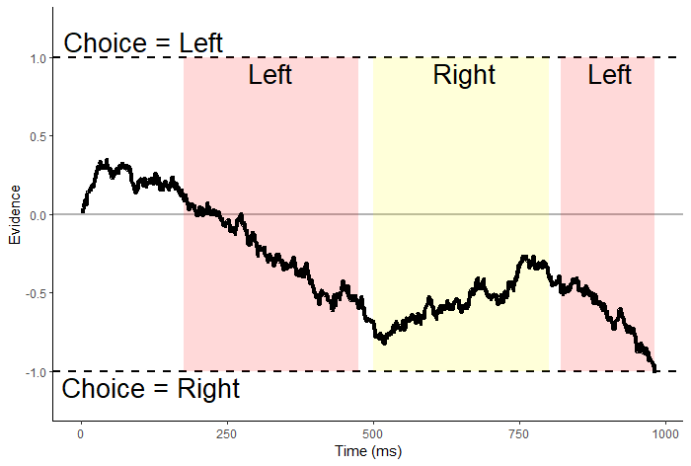
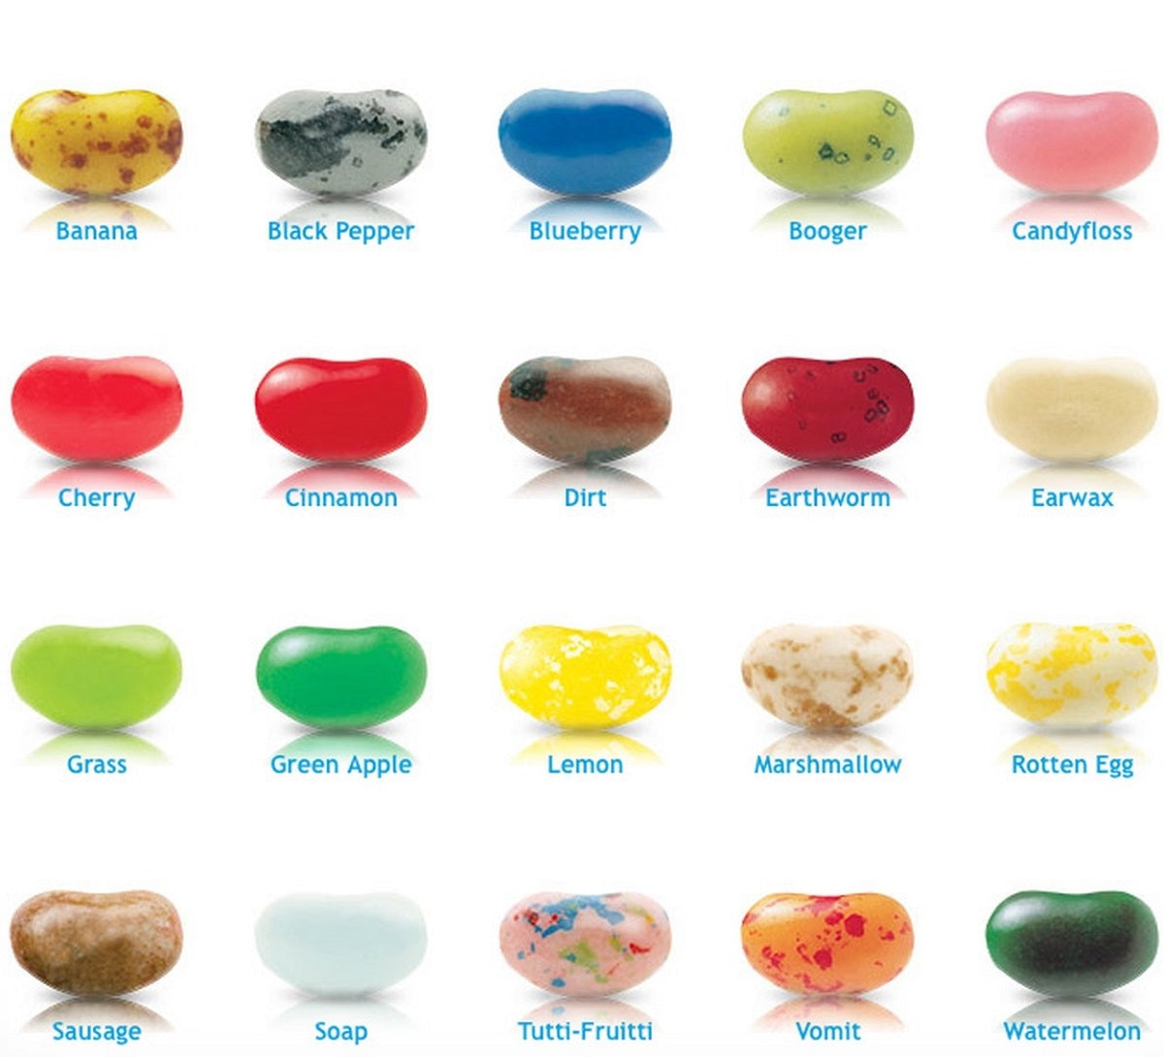
$evidence_{t}=evidence_{t−1}+μ_{t}+e_{t}$
Looking at earthworm: $μ_{t}=d(V_{Earthworm}−θV_{Earwax})$
Looking at earwax: $μ_{t}=d(θV_{Earthworm}−V_{Earwax})$
If $θ∈\left(0,1\right)$ and $V_{i}<0$. Then $θV_{i}>V_{i}$.
If attentional discounting persists in choices between losses,
then the value of the nonfixated option should seem less negative
(i.e. better than it actually is).

Slide 18
Attentional choice biases
Net Fixation Bias
Last Fixation Bias
Pr(Left Chosen)
Pr(Choose Last Fix.)
Final Time Advantage Left
Last Rating – Other Rating

Slide 19
Attentional choice biases
should flip!
Net Fixation Bias
Last Fixation Bias
Pr(Left Chosen)
Pr(Choose Last Fix.)
Final Time Advantage Left
Last Rating - Other Rating

Slide 20
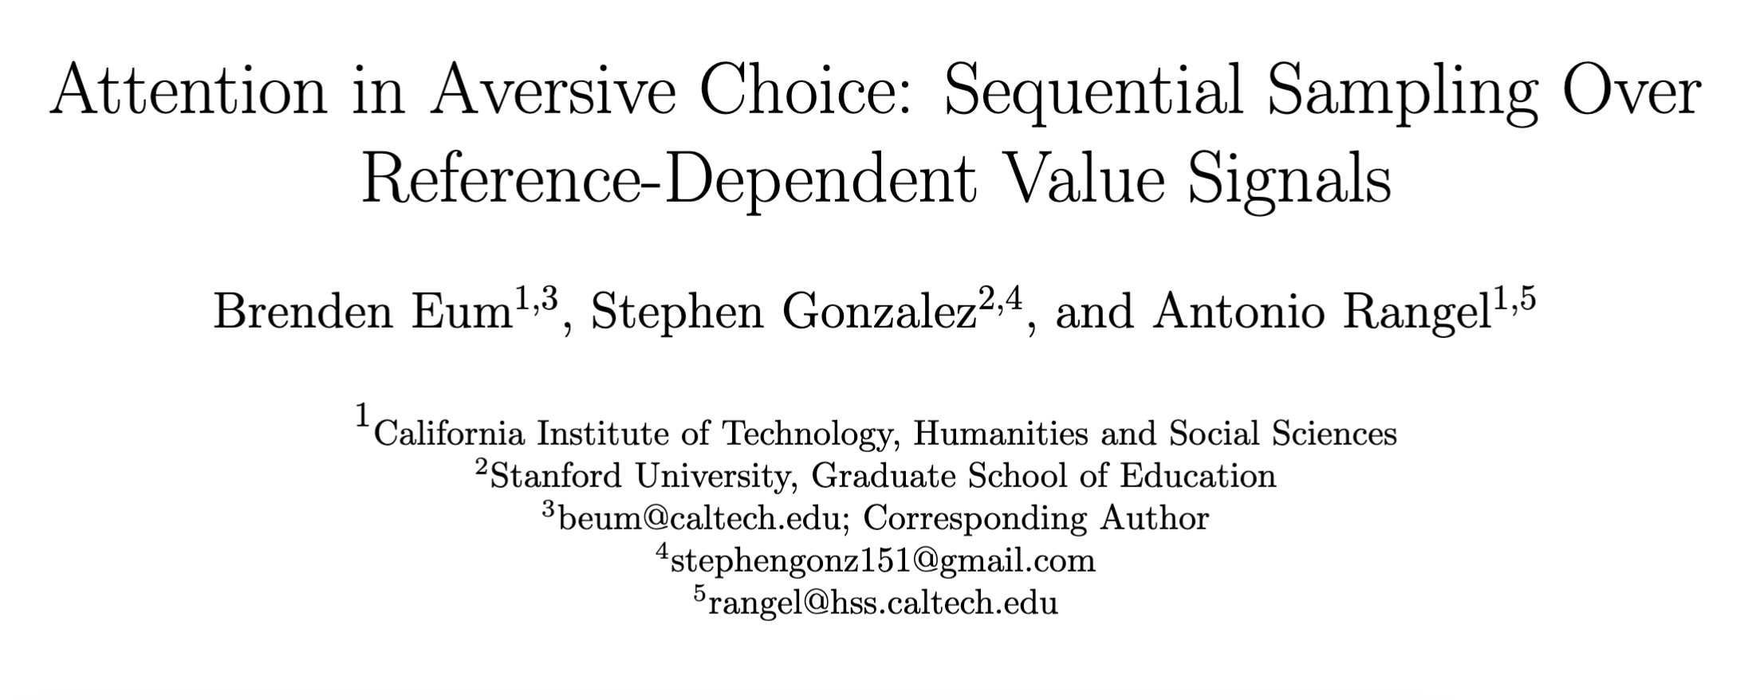

Slide 21
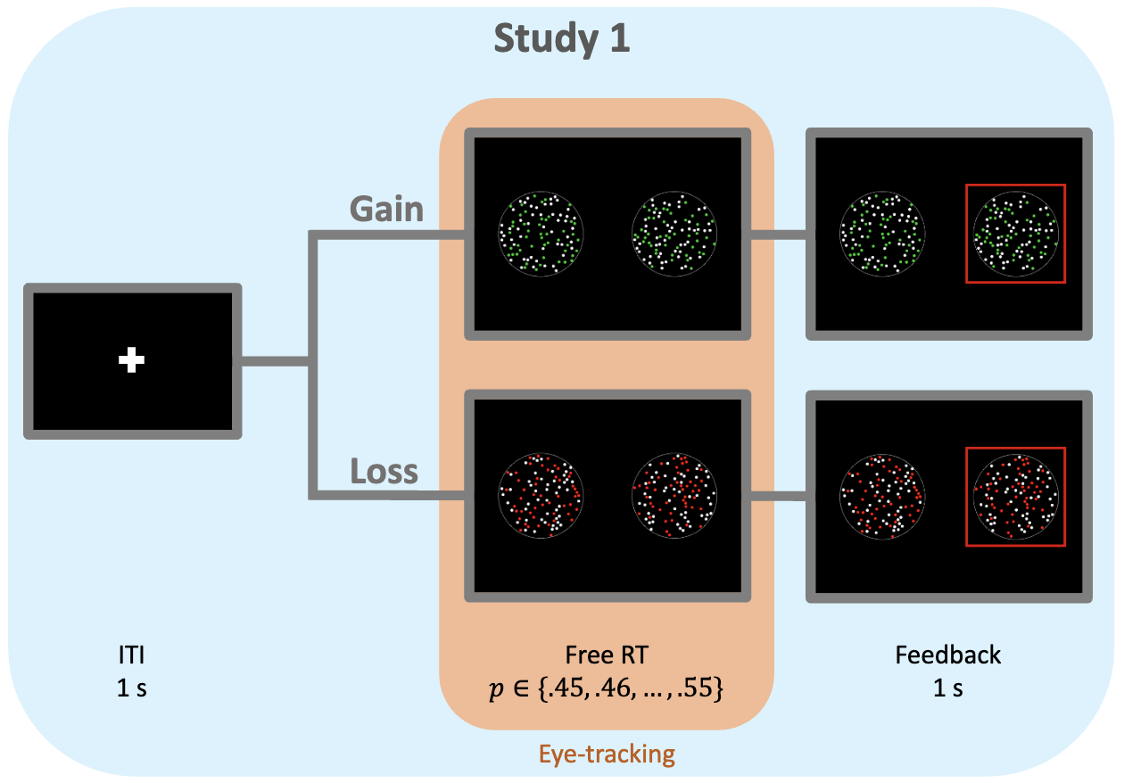

Slide 22
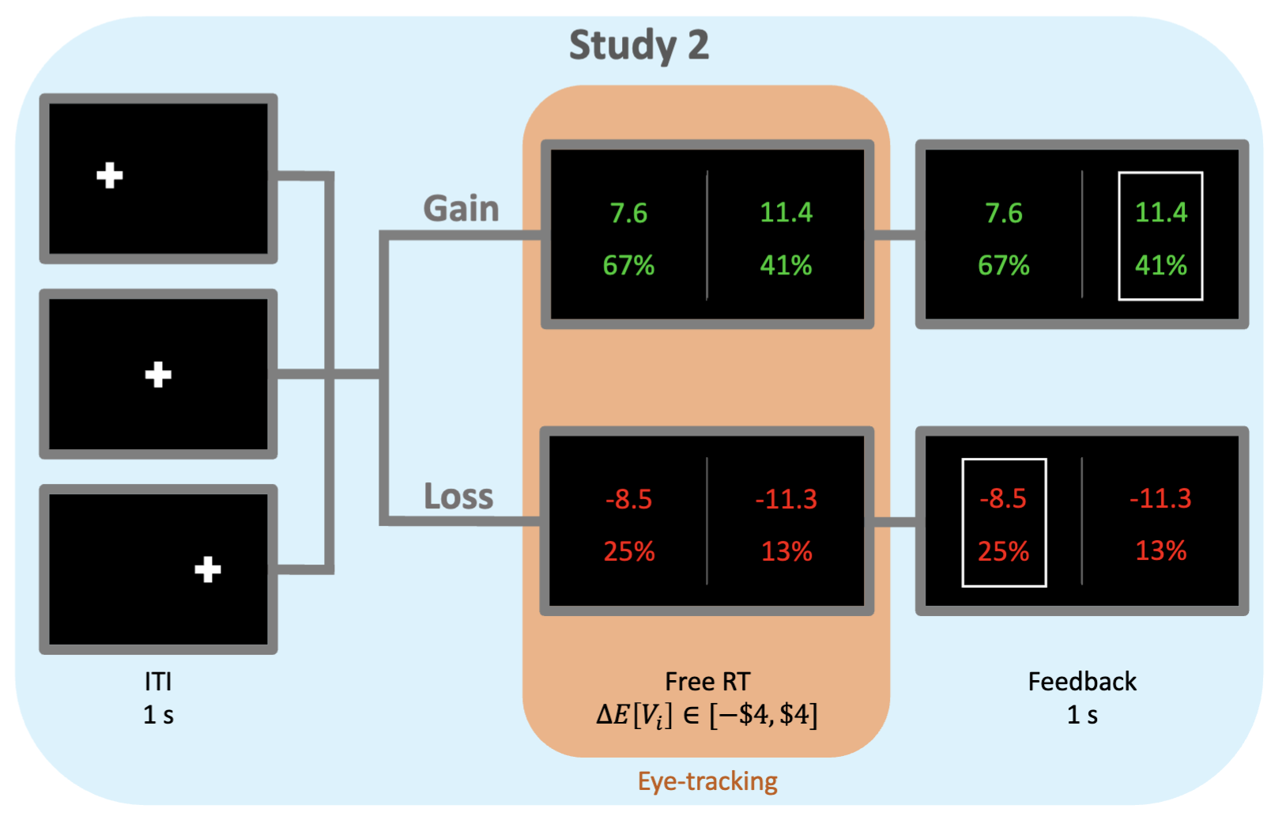

Slide 23
Attention in Risky Gains
Attention in Losses

Slide 24
Attention in Risky Gains
Attention in Losses
Net Fixation Bias
Fiedler, Glockner (2012, Front Psych)
Smith, Krajbich (2018, J Exp Psych)
Stewart, Hermens, Matthews (2016, JBDM)
Last Fixation Bias
Smith, Krajbich (2018, J Exp Psych)
Brandstatter, Korner (2014, Acta Psych)

Slide 25
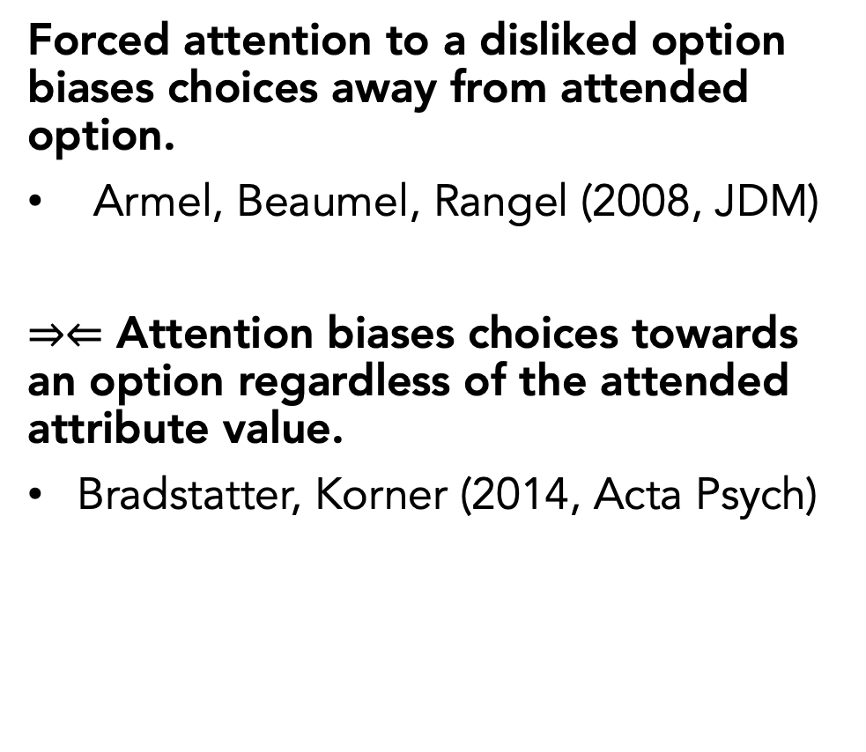
Attention in Risky Gains
Attention in Losses
Net Fixation Bias
Fiedler, Glockner (2012, Front Psych)
Smith, Krajbich (2018, J Exp Psych)
Stewart, Hermens, Matthews (2016, JBDM)
Last Fixation Bias
Smith, Krajbich (2018, J Exp Psych)
Brandstatter, Korner (2014, Acta Psych)
Forced attention to a disliked option biases choices away from attended option.
Armel, Beaumel, Rangel (2008, JDM)
$⇒⇐$ Attention biases choices towards an option regardless of the attended attribute value.
Bradstatter, Korner (2014, Acta Psych)

Slide 26
Attention in Risky Gains
Attention in Losses
Net Fixation Bias
Fiedler, Glockner (2012, Front Psych)
Smith, Krajbich (2018, J Exp Psych)
Stewart, Hermens, Matthews (2016, JBDM)
Last Fixation Bias
Smith, Krajbich (2018, J Exp Psych)
Brandstatter, Korner (2014, Acta Psych)
Mixed evidence for role of attention.
Forced attention to a disliked option biases choices away from attended option.
Armel, Beaumel, Rangel (2008, JDM)
$⇒⇐$ Attention biases choices towards an option regardless of the attended attribute value.
Bradstatter, Korner (2014, Acta Psych)

Slide 27
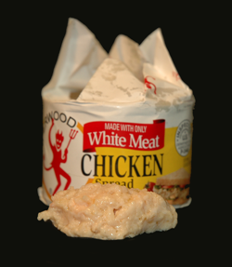
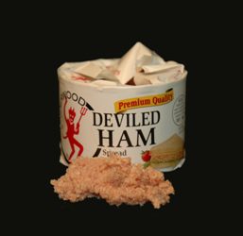
+
1
They use food. We use money.
…
6x
300 ms
Choose
600 ms
300 ms
600 ms
7.2 seconds
2
Up to ~4.8x longer than most free RTs!
3
Sequential presentation artificially encourages attentional bias reversals.
See Basu & Savani (2019, Curr Dir Psych Sci) for a review of sequential vs. simultaneous presentation.

Slide 28
Basic Psychometrics

Slide 29
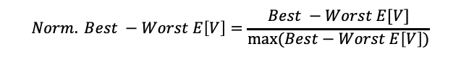
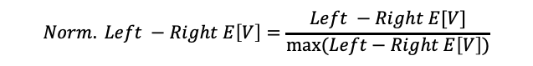
Basic Psychometrics
$$Norm. Left −Right E\left[V\right]=\frac{Left −Right E[V]}{max⁡(Left−Right E\left[V\right])}$$
$$Norm. Best −Worst E\left[V\right]=\frac{Best −Worst E[V]}{max⁡(Best−Worst E\left[V\right])}$$

Slide 30
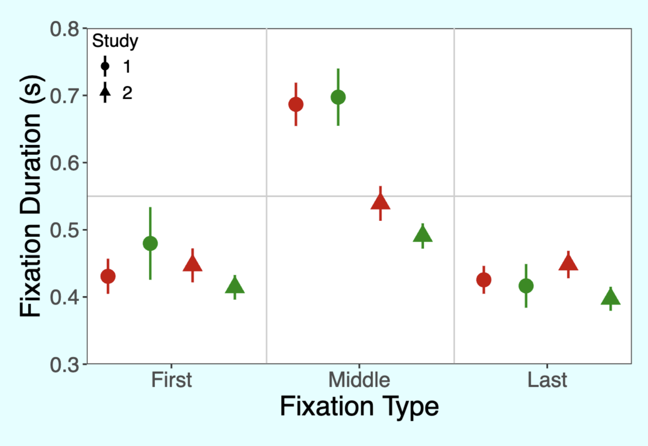
Fixation Process

Slide 31
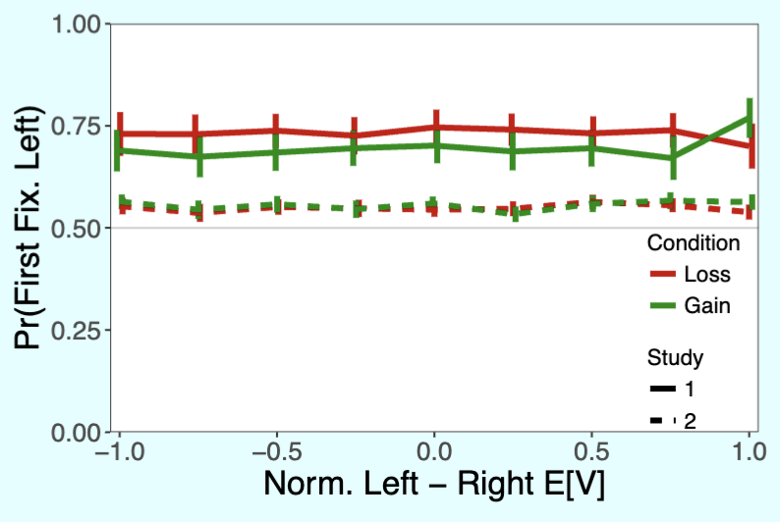
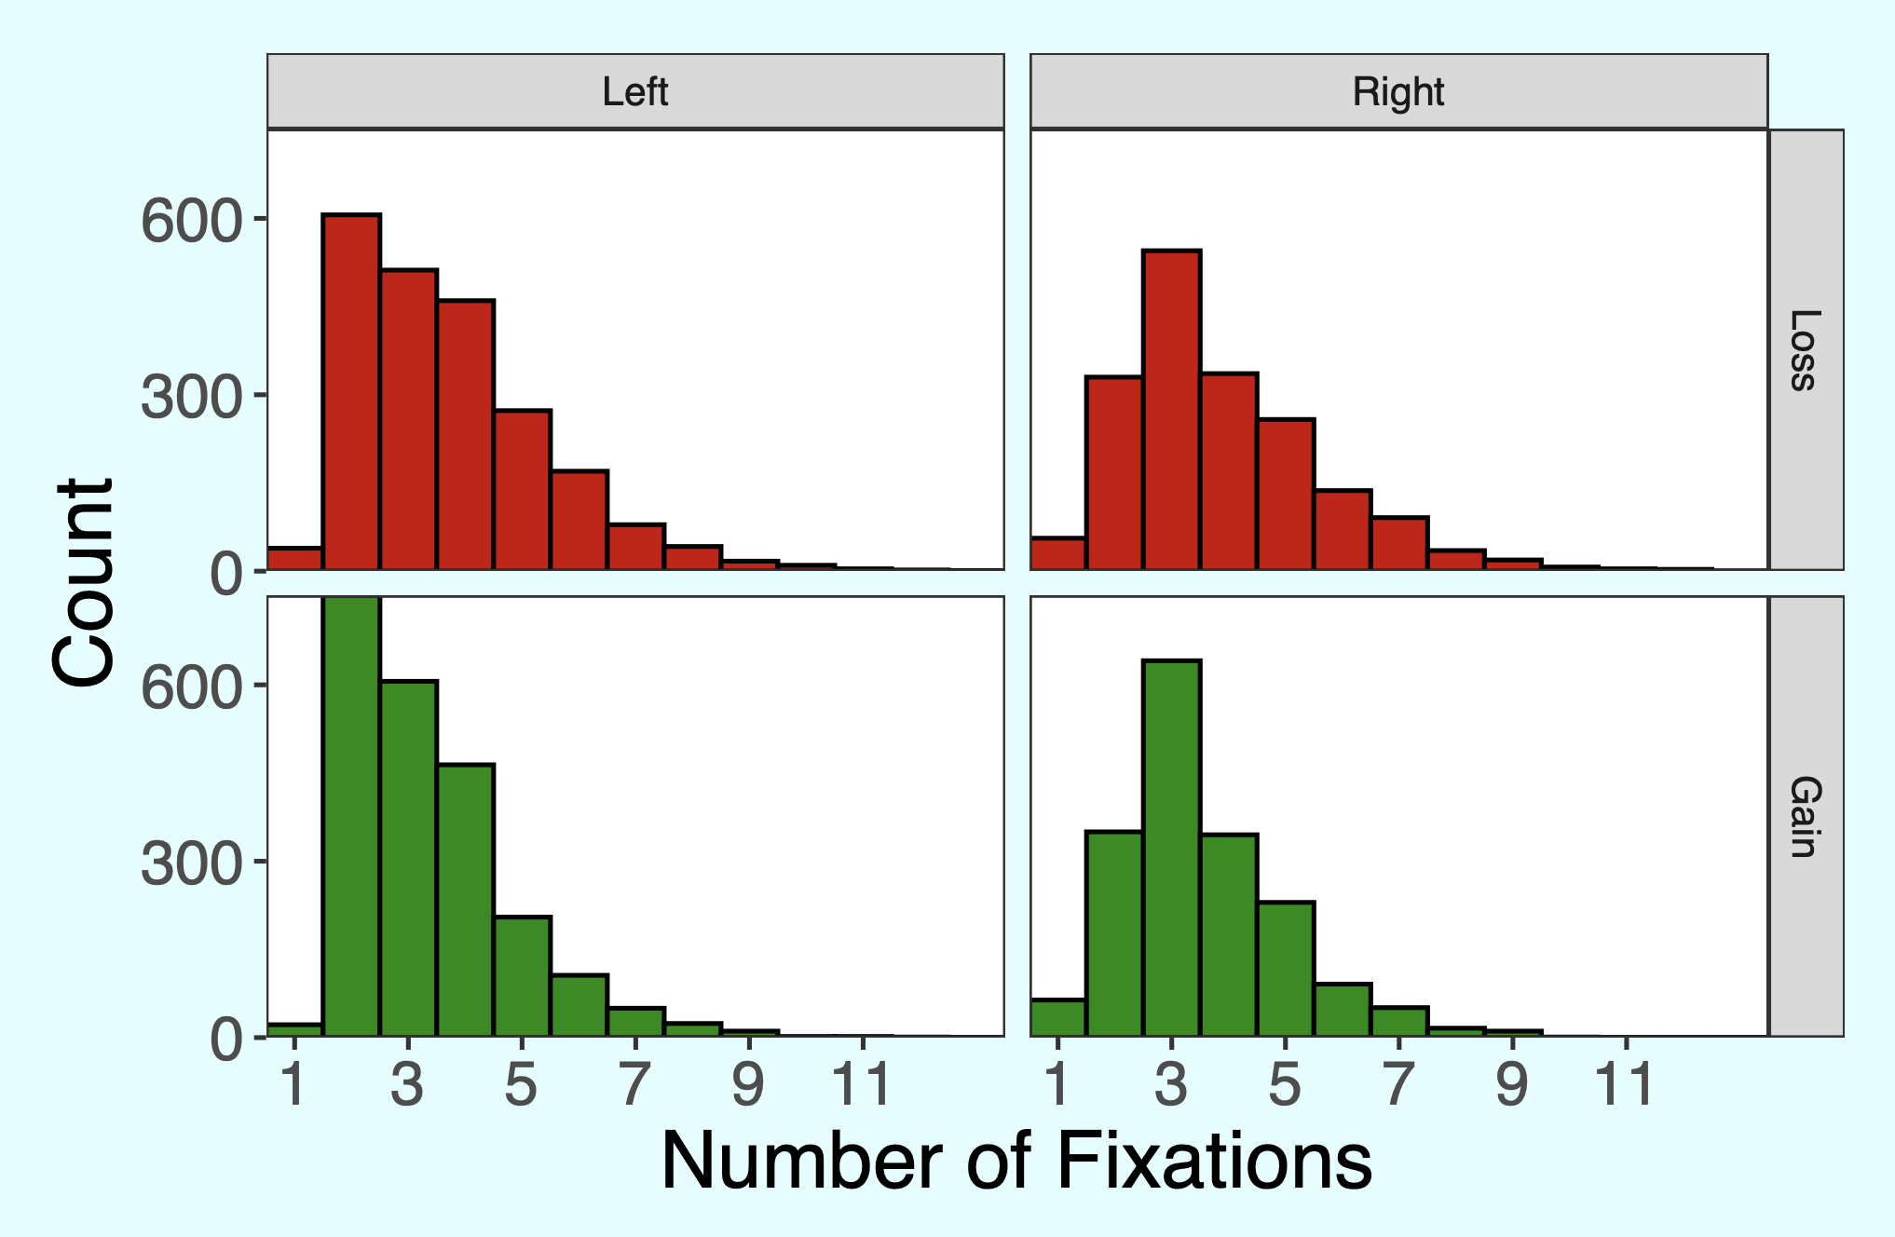
Why the right-hand-side fixation bias in study 2?
Study 2

Slide 32
Predicted Attentional Choice Bias Reversals
Net Fixation Bias
Last Fixation Bias
Pr(Left Chosen)
Pr(Choose Last Fix.)
Final Time Advantage Left
Left Rating - Right Rating

Slide 33
No Attentional Choice Bias Reversals
Net Fixation Bias
Last Fixation Bias
Pr(Left Chosen)
Pr(Choose Last Fix.)
Final Time Advantage Left
Left Rating - Right Rating

Slide 34
No Attentional Choice Bias Reversals
Net Fixation Bias
Last Fixation Bias
Pr(Left Chosen)
Pr(Choose Last Fix.)
Final Time Advantage Left
Left Rating - Right Rating

Slide 35
No Attentional Choice Bias Reversals
Net Fixation Bias
Last Fixation Bias
Pr(Left Chosen)
Pr(Choose Last Fix.)
Can we reconcile these results with the aDDM?
Final Time Advantage Left
Left Rating - Right Rating

Slide 36
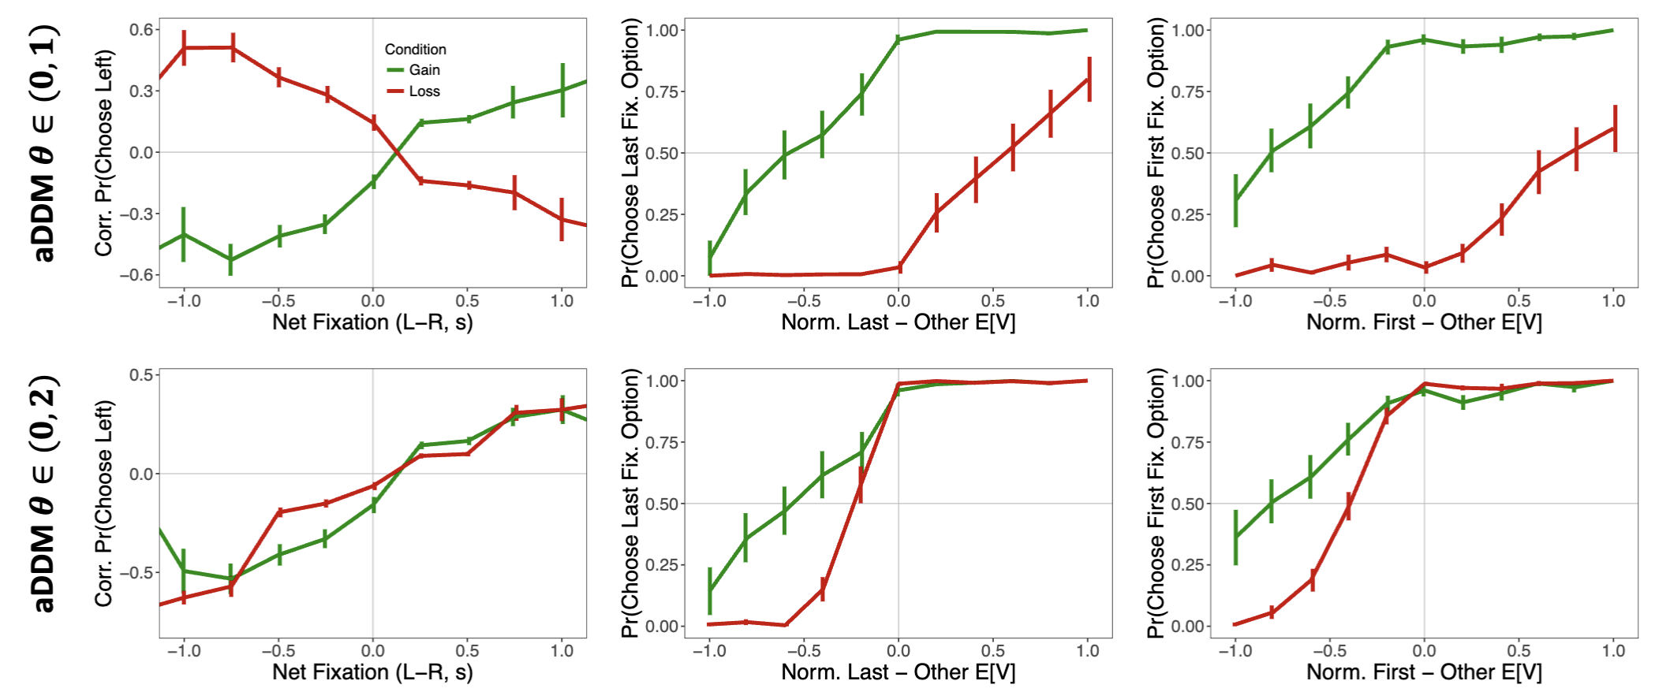
Simulations show it is impossible with $θ∈(0,1)$.
Simulations

Slide 37
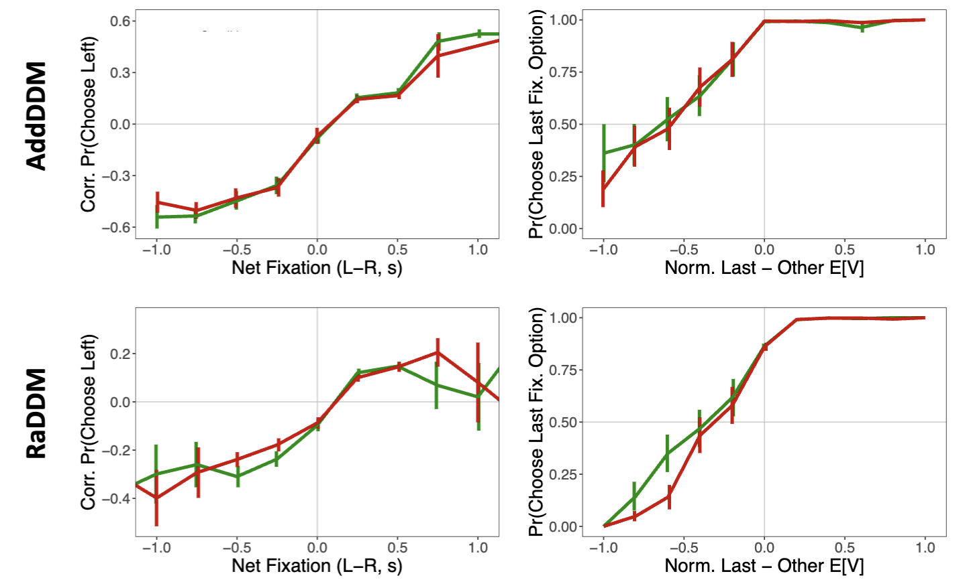
Simulations show there are two variations of the aDDM that can explain our data.
Additive Model of Attention
aDDM with Reference-Dependent Value Signals

Slide 38
Why these two models?
Additive Model of Attention
There is a debate between value-dependent and value-independent attentional effects in the literature [Cavanaugh et al. (2014, J Exp Psych Gen)].
Smith and Krajbich (2019, Psych Sci) showed that it fails to capture some relationships between RT and OV, but we showed that it is capable of explaining our observed attentional biases.

Slide 39
Why these two models?
aDDM with Reference-Dependent Value Signals
Normalization of value signals
Padoa-Schioppa (2009) Range normalization
Frydman and Jin (2022) Normalization can occur within limited trials
Rangel and Clithero (2012) Review of normalization
Other good papers mentioned in Frydman and Jin
Tobler, Fiorillo, and Schultz (2005), Carandini and Heeger (2012),
Div norm stuff: Louie and Glimcher (2012), Khaw, Glimcher, Louie (2017), Ryan has some papers on this too
Soltani, De Martino, Camerer (2012) -> reminds me of Heng, Woodford, Polania (2023)

Slide 40
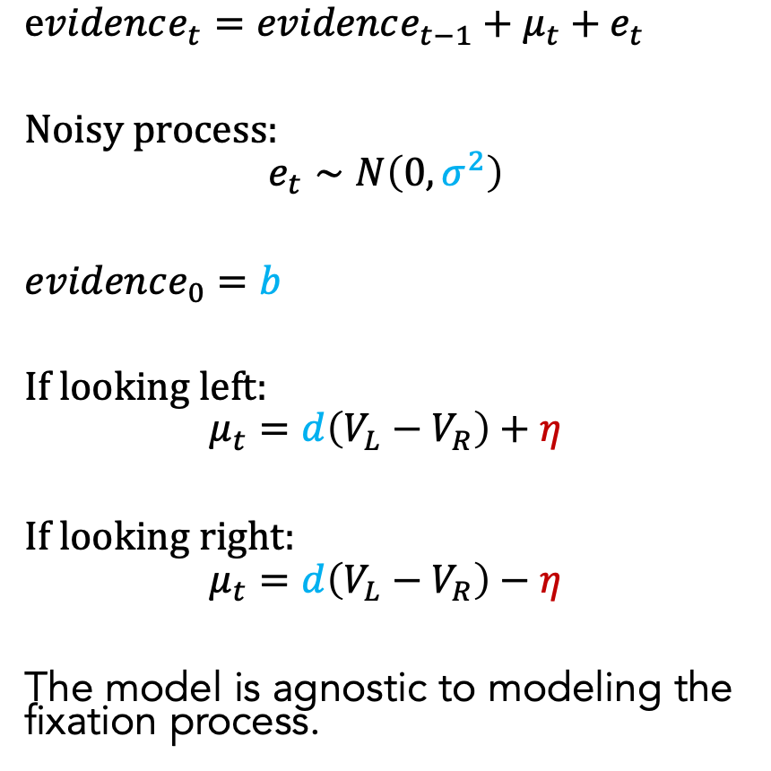
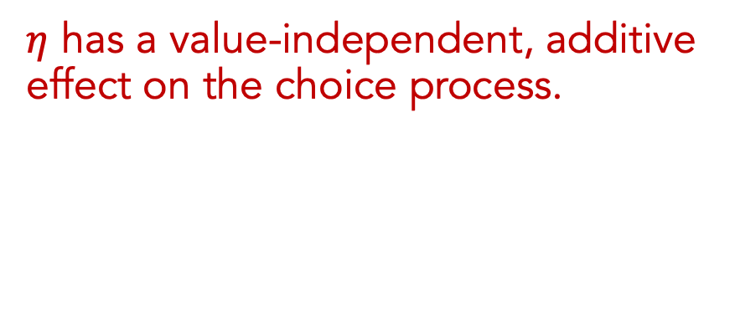
Additive Model of Attention (AddDDM)
$evidence_{t}=evidence_{t−1}+μ_{t}+e_{t}$
Noisy process:
$$e_{t}∼N\left(0, σ^{2}\right)$$
$evidence_{0}=b$
If looking left:
$$μ_{t}=d\left(V_{L}−V_{R}\right)+η$$
If looking right:
$$μ_{t}=d\left(V_{L}−V_{R}\right)−η$$
The model is agnostic to modeling the fixation process.
$η$ has a value-independent, additive effect on the choice process.
Attention in Losses | Dynamic Evidence Weights
Notes:
noisy
bias
drift: ddm in value based decisions: evidence accumulated is value comparison
drift
sim
explain fixation sampling process

Slide 41
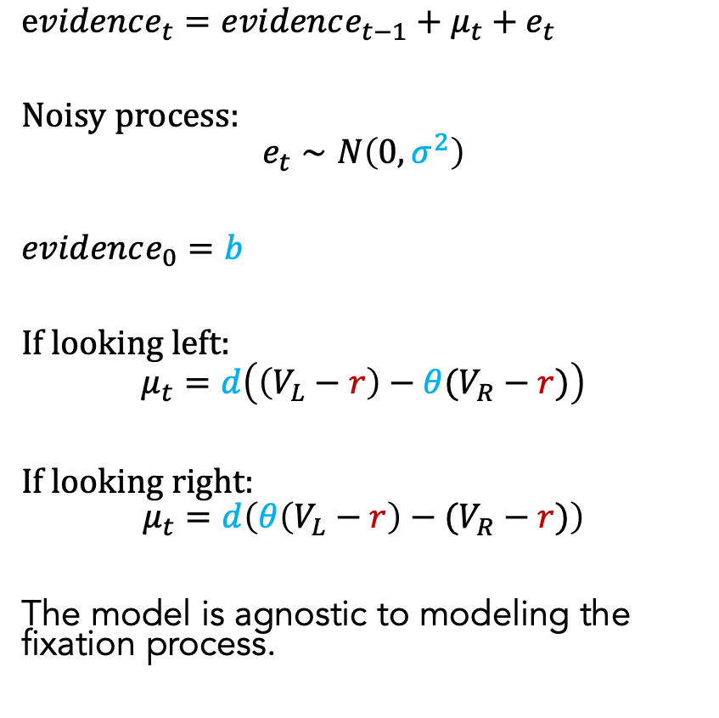
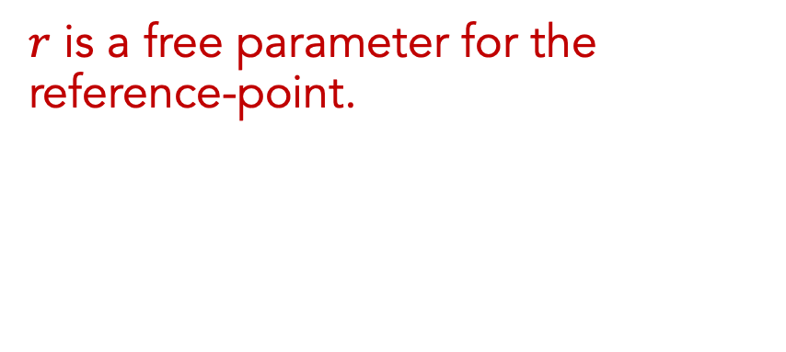
Reference-Dependent aDDM (RaDDM)
$evidence_{t}=evidence_{t−1}+μ_{t}+e_{t}$
Noisy process:
$$e_{t}∼N\left(0, σ^{2}\right)$$
$evidence_{0}=b$
If looking left:
$$μ_{t}=d\left(\left(V_{L}−r\right)−θ(V_{R}−r)\right)$$
If looking right:
$$μ_{t}=d\left(θ\left(V_{L}−r\right)−(V_{R}−r)\right)$$
The model is agnostic to modeling the fixation process.
$r$ is a free parameter for the reference-point.
Attention in Losses | Dynamic Evidence Weights
Notes:
noisy
bias
drift: ddm in value based decisions: evidence accumulated is value comparison
drift
sim
explain fixation sampling process

Slide 42
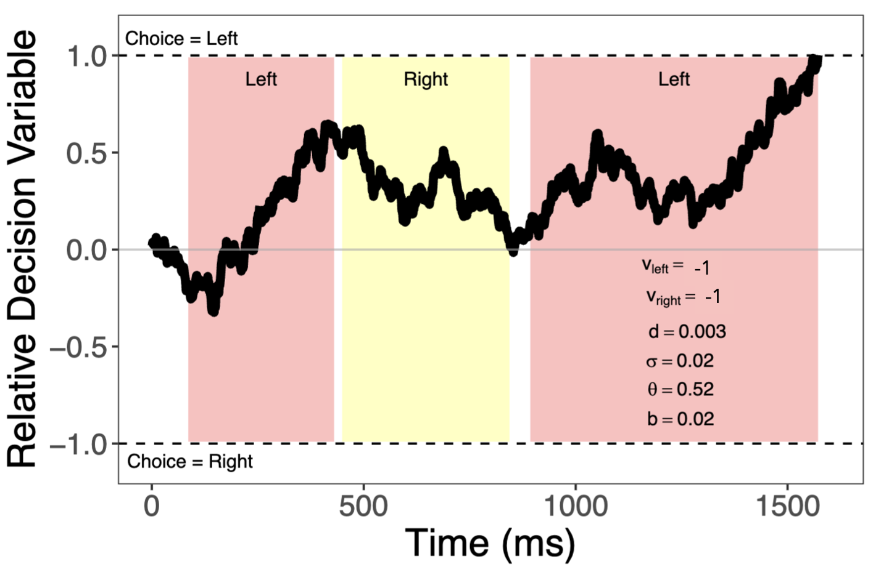
RaDDM in Losses

Slide 43
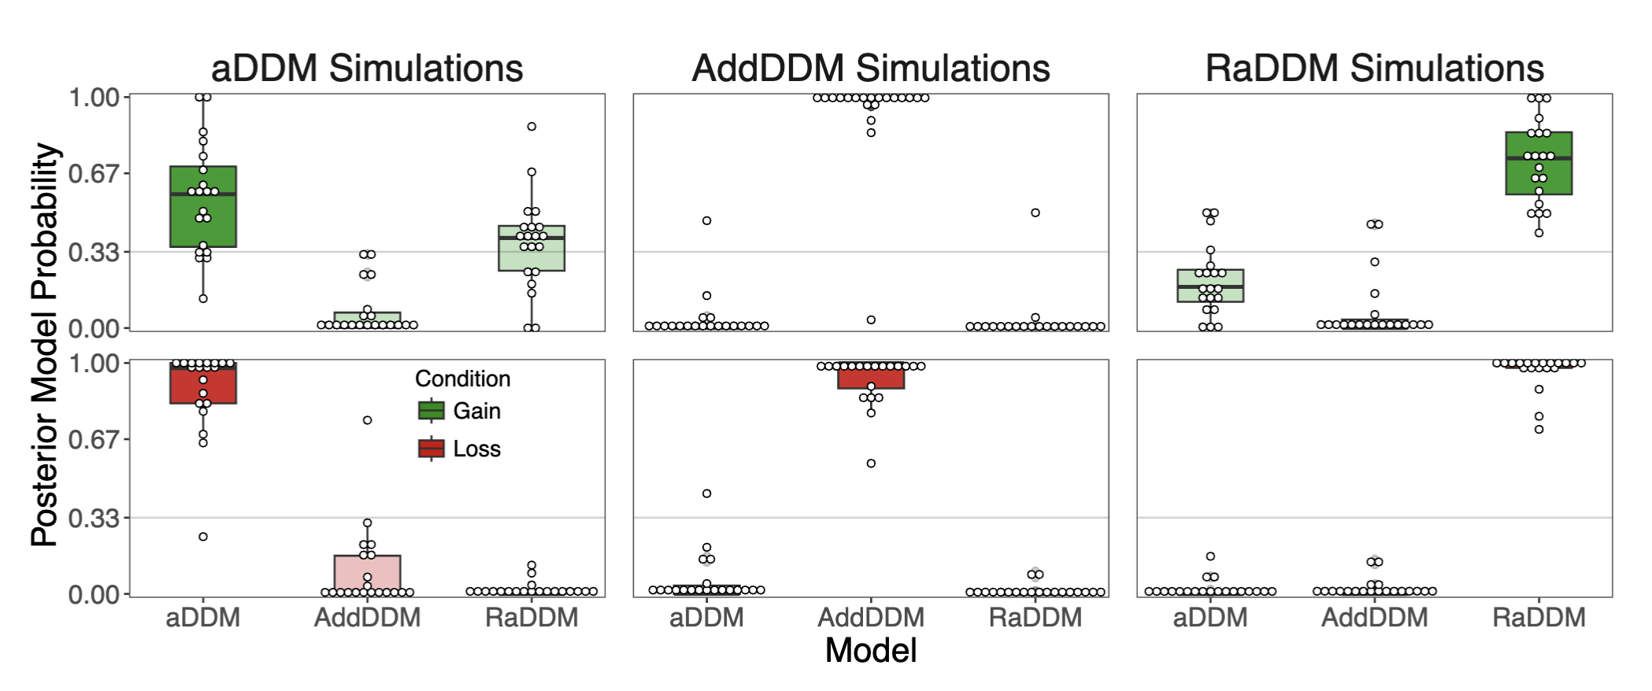
The models are recoverable.

Slide 44
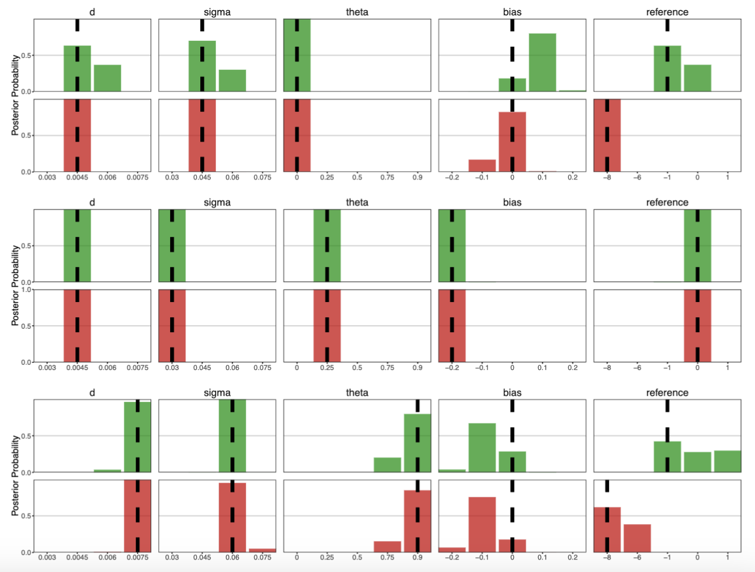
RaDDM successfully recovers parameters.

Slide 45
RaDDM successfully recovers parameters.
How do we pick between the AddDDM and RaDDM?

Slide 46
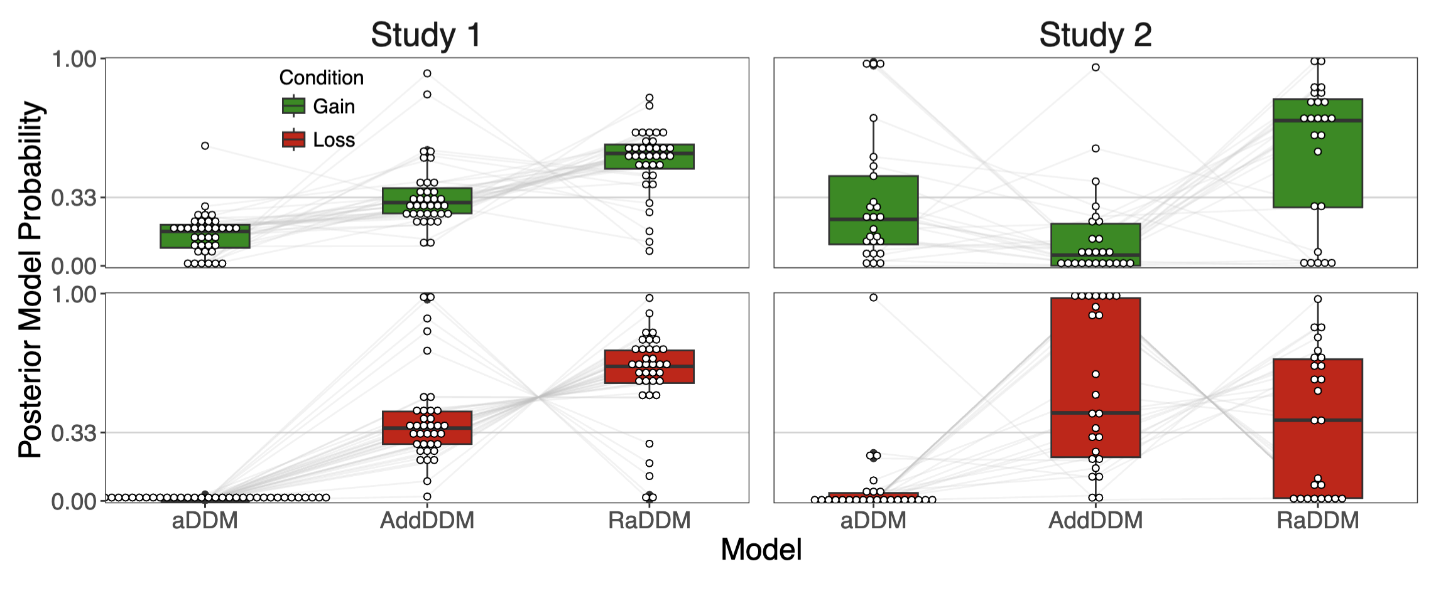
Model comparison favors RaDDM, but not convincingly.

Slide 47
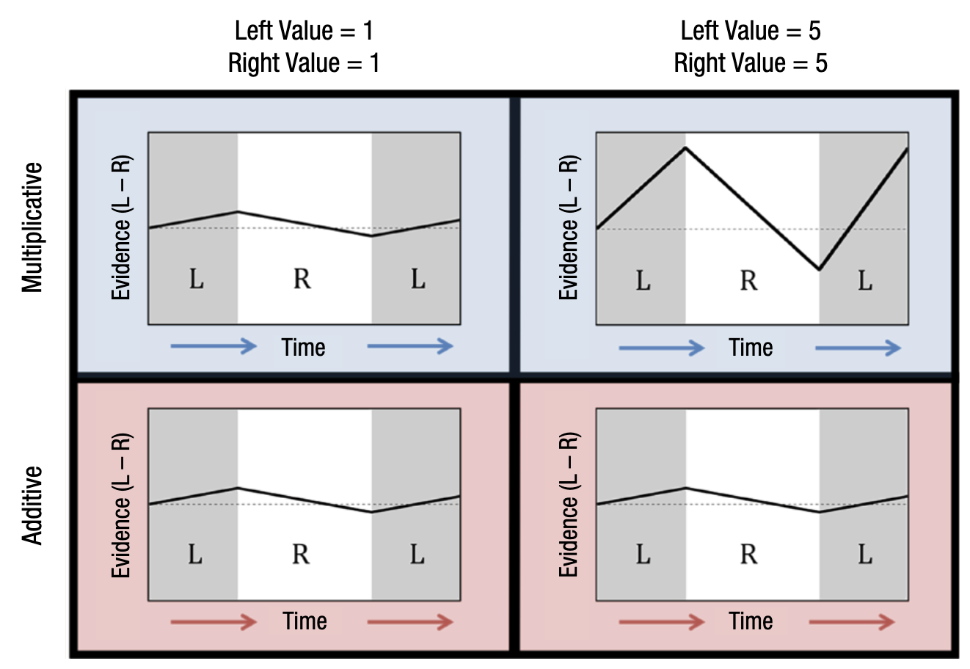

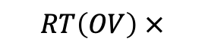
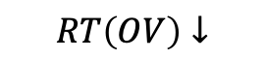
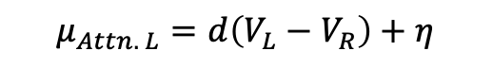
Behavioral Signature: RT(OV) in Losses
$$μ_{Attn. L}=d(V_{L}−θV_{R})$$
$$RT\left(OV\right)↓$$
$$RT\left(OV\right) ×$$
$$μ_{Attn. L}=d\left(V_{L}−V_{R}\right)+η$$
Smith, Krajbich (2019, Psych Sci) Fig. 2

Slide 48
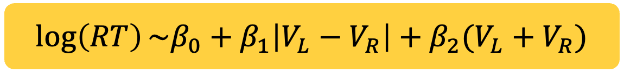
Behavioral Signature: RT(OV) in Losses
$$μ_{Attn. L}=d(V_{L}−θV_{R})$$
$$RT\left(OV\right)↓$$
$$\log\left(RT\right)\sim β_{0}+β_{1}\left|V_{L}−V_{R}\right|+β_{2}(V_{L}+V_{R})$$
$$RT\left(OV\right) ×$$
$$μ_{Attn. L}=d\left(V_{L}−V_{R}\right)+η$$
Smith, Krajbich (2019, Psych Sci) Fig. 2

Slide 49

Behavioral Signature: RT(OV) in Losses
-1
-5
-1
-5
$$μ_{Attn. L}=d(V_{L}−θV_{R})$$
$$RT\left(OV\right)↑$$
$$RT\left(OV\right) ×$$
$$μ_{Attn. L}=d\left(V_{L}−V_{R}\right)+η$$

Slide 50
If reference-points in the RaDDM $≤$ the minimum value in a condition:
-1
-5
-1
-5
$$μ_{Attn. L}=d(V_{L}−θV_{R})$$
$$RT\left(OV\right)↓$$
$$RT\left(OV\right) ×$$
$$μ_{Attn. L}=d\left(V_{L}−V_{R}\right)+η$$

Slide 51
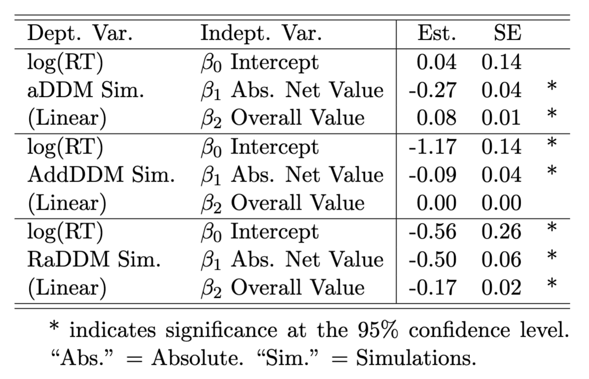
Simulated $\log\left(RT_{Loss}\right)\sim β_{0}+β_{1}\left|V_{L}−V_{R}\right|+β_{2}(V_{L}+V_{R})$
Each model makes different predictions about RT(OV) in losses.

Slide 52
Simulated $\log\left(RT_{Loss}\right)\sim β_{0}+β_{1}\left|V_{L}−V_{R}\right|+β_{2}(V_{L}+V_{R})$

Slide 53
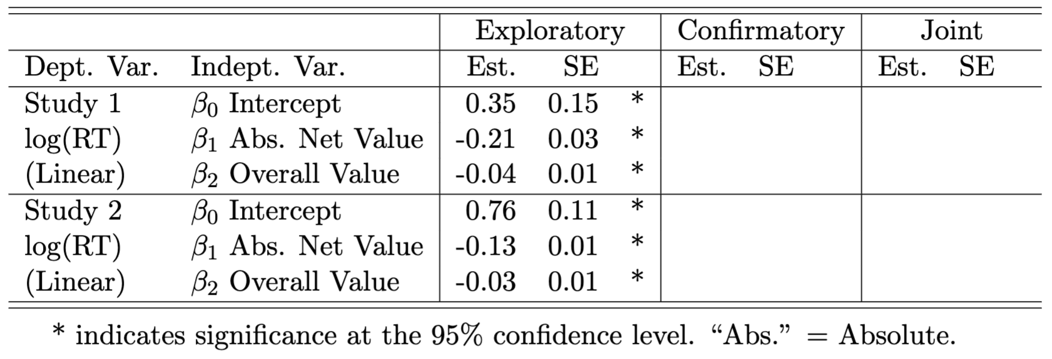
Observed $\log\left(RT_{Loss}\right)\sim β_{0}+β_{1}\left|V_{L}−V_{R}\right|+β_{2}(V_{L}+V_{R})$

Slide 54
Observed $\log\left(RT_{Loss}\right)\sim β_{0}+β_{1}\left|V_{L}−V_{R}\right|+β_{2}(V_{L}+V_{R})$
People are behaving according to the RaDDM with reference-points at or below the minimum value in a context.

Slide 55
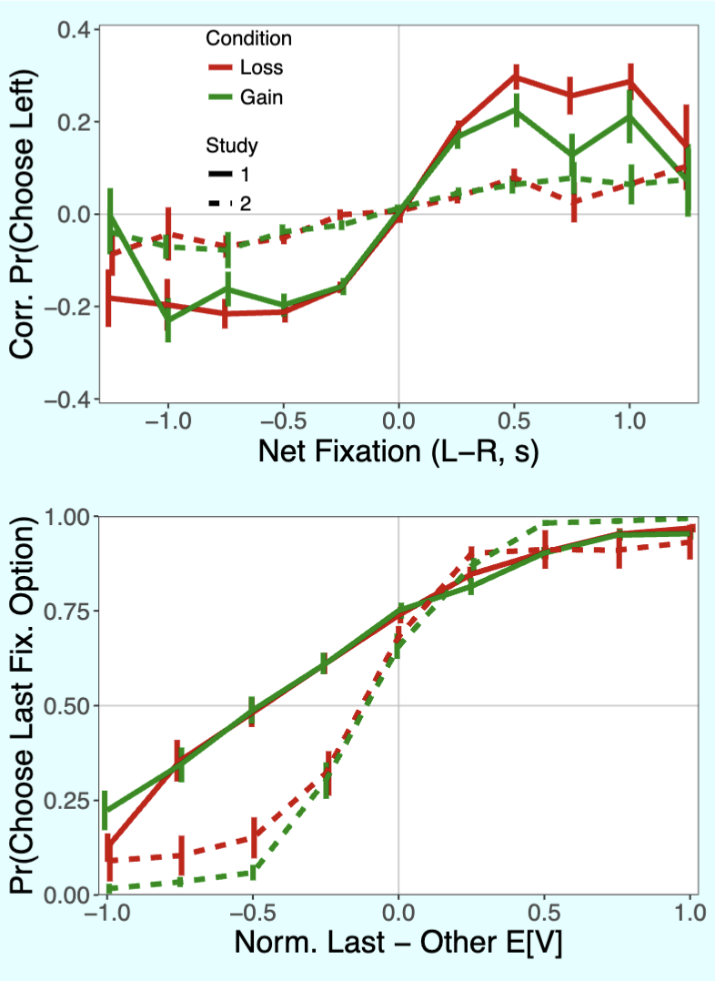

RaDDM: Group-Level Estimates
Observed

Slide 56
RaDDM: Group-Level Estimates
Observed

Slide 57

RaDDM: Individual-Level Estimates

Slide 58
RaDDM: Individual-Level Estimates

Slide 59
RaDDM: Individual-Level Estimates

Slide 60
RaDDM: Individual-Level Estimates

Slide 61
RaDDM: Individual-Level Estimates

Slide 62

RaDDM: Out-of-Sample Predictive Checks

Slide 63
Summary
Attention is pulling choices towards the attended item in both choices between gains and between losses. This is not predicted by the standard aDDM.
Extending the aDDM to include reference-dependent value signals allows us to explain behavior in the loss condition.
People seem to be using reference-points set at or below the minimum value in a given context.

Slide 64


The DDM is one of the most popular models for simple choices…
See Ratcliff et al. (2016, Psych Rev) for a review of the DDM.

Slide 65

… but it relies on some strong assumptions.
$evidence_{t}=evidence_{t−1}+μ_{t}+e_{t}$
Drift:
$$μ_{t}=d\left(V_{L}−V_{R}\right)$$
Noise:
$$e_{t}∼N\left(0, σ^{2}\right)$$
Bias:
$evidence_{0}=b$

Slide 66
… but it relies on some strong assumptions.
$evidence_{t}=evidence_{t−1}+μ_{t}+e_{t}$
Drift:
$$μ_{t}=d\left(V_{L}−V_{R}\right)$$
Noise:
$$e_{t}∼N\left(0, σ^{2}\right)$$
Bias:
$evidence_{0}=b$
Information is weighted equally throughout the choice process.
1

Slide 67
… but it relies on some strong assumptions.
$evidence_{t}=evidence_{t−1}+μ_{t}+e_{t}$
Drift:
$$μ_{t}=d\left(V_{L}−V_{R}\right)$$
Noise:
$$e_{t}∼N\left(0, σ^{2}\right)$$
Bias:
$evidence_{0}=b$
Information is weighted equally throughout the choice process.
1
Value signals do not undergo transformations prior to evidence accumulation.
2

Slide 68
… but it relies on some strong assumptions.
$evidence_{t}=evidence_{t−1}+μ_{t}+e_{t}$
Drift:
$$μ_{t}=d\left(V_{L}−V_{R}\right)$$
Noise:
$$e_{t}∼N\left(0, σ^{2}\right)$$
Bias:
$evidence_{0}=b$
Information is weighted equally throughout the choice process.
1
Value signals do not undergo transformations prior to evidence accumulation.
2
3
Noise is value-independent (i.e. additive).

Slide 69
Why might true processes differ from these assumptions?
Information is weighted equally throughout the choice process.
1
Working memory and sequential sampling are closely linked [Shadlen & Shohamy (2016, Neuron)].
“Unless memory updating is rapid and effortless, one would expect working memory capacity limitations to have a significant effect on performance.” [Ratcliff et al. (2016, Trend Cog Sci).
Primacy and/or leakage effects [Usher & McClelland (2001, Psych Rev); Ashby et al. (2016, JEP)]

Slide 70
Why might true processes differ from these assumptions?
Value signals do not undergo transformations prior to evidence accumulation.
2
Range Normalization [Padoa-Schioppa (2009, J Neuro); Rangel & Clithero (2012, Curr Op Neurobio)]
Efficient Coding [Heng, Woodford, Polania (2023); Frydman & Jin (2023, QJE)]
Divisive Normalization [Louie, Khaw, Glimcher (2013, PNAS); Webb, Glimcher, Louie (2020, Nat Hum Beh)]
Goal-Relevant Value and Numerosity Encoding [Sepulveda et al. (2020, eLife); Clarmann von Clarenau et al. (2024)]
* Loss and Risk Aversion [Tversky & Kahneman (1992, J Risk Uncert); Khaw, Li, Woodford (2021, Restud)]

Slide 71
Why might true processes differ from these assumptions?
3
Noise is value-independent (i.e. additive).
Efficient Coding [Cheyette & Piantadosi (2020, Nat Hum Beh); Prat-Carrabin & Woodford (2022, Nat Hum Beh); Frydman & Jin (2023, QJE)]

Slide 72


Slide 73


SD=2
-2
-1
0
1
2

Slide 74

SD=2
-2
-1
0
1
2
+
Prolific
300 Trials
6 Blocks
300 ms
300 ms
300 ms

Slide 75


Slide 76
Information is weighted equally throughout the choice process.
1
Value signals do not undergo transformations prior to evidence accumulation.
2
3
Noise is value-independent (i.e. additive).

Slide 77
Behavioral Results

Slide 78
Basic Psychometrics

Slide 79
Behavior Looks Like Sequential Sampling

Slide 80
Hints of Primacy Effects

Slide 81
Hints of Recency Effects (or Leakage)…
…and non-decision time.

Slide 82




Next Steps: Parameter Recovery and Fitting
$evidence_{t}=evidence_{t−1}+μ_{t}+g(e_{t}|V_{t})$
Drift:
$$μ_{t}=d(t)∗f(V_{t}|V_{t−1},V_{t−2},…)$$
Noise:
$$e_{t}∼N\left(0, σ^{2}\right)$$
Bias:
$evidence_{0}=b$
$$g\left(⋅\right)=e_{t}V_{t}$$
Information is weighted equally throughout the choice process.
1
$$d\left(t\right)=d_{0}+t^{α}$$
$$f\left(V_{t} | ⋅\right)=V_{t}−min⁡(V)$$
Value signals do not undergo transformations prior to evidence accumulation.
2
3
Noise is value-independent (i.e. additive).

